Slide 1
20XD14 -Problem Solving and C Programming
Functions in C

Slide 2
Outline
Functions in C
Why are functions needed?
Advantages of functions
Library functions Vs user-defined functions
Components of a user-defined function
Function call stack and activation records
Categories of user –defined functions
Nested function calls
Function call stack and activation records
Parameter passing mechanisms
Passing arrays to functions
Storage classes
Recursion

Slide 3
Function
A function is a self-contained block of program statements that performs a particular task
Imagine a program wherein a set of operations has to be repeated often, though not continuously, n times or so
Instead of inserting the program statements for these operations at so many places, write a separate program segment and compile it separately
As many times as it is needed, keep ‘calling’ the segment to get the result
The separate program segment is called a function and the program that calls it is called the ‘main program’

Slide 4
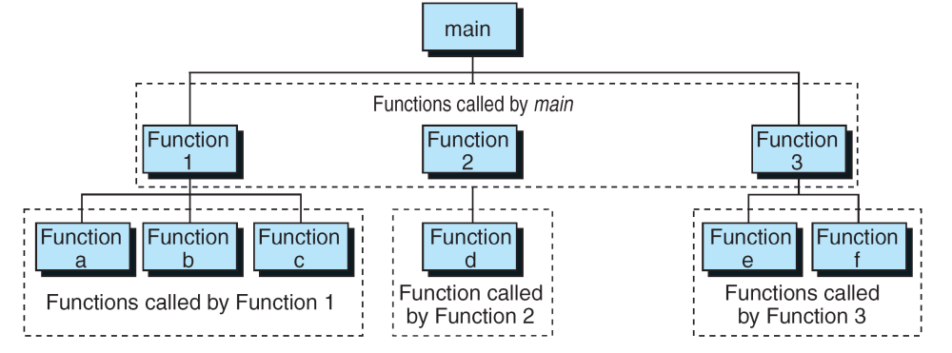
Functions in C
In C, the idea of top–down design is done using functions
A C program is made of one or more functions, one and only one of which must be named main
The execution of the program always starts with main, but it can call other functions to do some part of the job

Slide 5
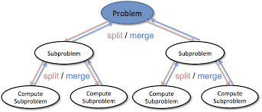
Functions in C
Divide and Conquer
  Construct a program from smaller pieces or components
    These smaller pieces are called modules
  Each piece more manageable than the original program

Slide 6
Why are Functions Needed?
The program may become too large and complex and as a result the task of debugging, testing, and maintaining becomes difficult
  it makes programs significantly easier to understand and maintain by breaking up a program into easily manageable chunks
A piece of a code which repeats at many places can be written only once and used again and again
  ie., well written functions may be reused in multiple programs
Functions can be used to protect data. This is related with the concept of local data. They are available only within a function when the function is being executed
Different programmers working on one large project can divide the workload by writing different functions

Slide 7
Advantages of using Functions
Modular Programming: It facilitates top down modular programming
Reduction of Source Code: The length of the source program can be reduced by using functions at appropriate places
Easier Debugging: It is easy to locate and isolate a faulty function for further investigation
Code Reusability: A program can be used to avoid rewriting the same sequence of code at two or more locations in a program
Function Sharing: Programming teams does a large percentage of programming. If the program is divided into subprograms, each subprogram can be written by one or two team members of the team rather than having the whole team to work on the complex program

Slide 8
Functions in C
Library functions or built-in functions
  Library functions are not required to be written by us
  The standard C library is collection of various types of functions which perform some standard and predefined tasks
  printf(),scanf(),sqrt(), cos(), strcat(),rand(), etc are some of library functions
User defined functions
  Programmers can create their own function to perform a specific task
  Example: main (), sum (), fact () , show(), display() and etc.,

Slide 9
Components of user-defined Functions
Three components
  Function declaration (or) Function Prototype
  Function definition
  Function call

Slide 10
1. Function Prototype
In C, user-defined function should normally be declared prior to its use to allow the compiler to perform type checking on the arguments used in its call statement or calling construct
Syntax
return_type function_name (type1 arg1, type2 arg2, …type n argn);
return-type
  Specifies the type of value that a function returns using the return statement
  It can be any valid data type
  If no data type is specified the function is assumed to return an integer result

Slide 11
1. Function Prototype
Function-name
  Must follow same rules of variable names in C
  No two functions have the same name in a C program
argument declaration
  It is a comma-separated list of variables that receive the values of the argument when function is called
  If there is no argument declaration the bracket consists of keyword void
A function name is used three times in a C program: for declaration, in a call, and for definition

Slide 12
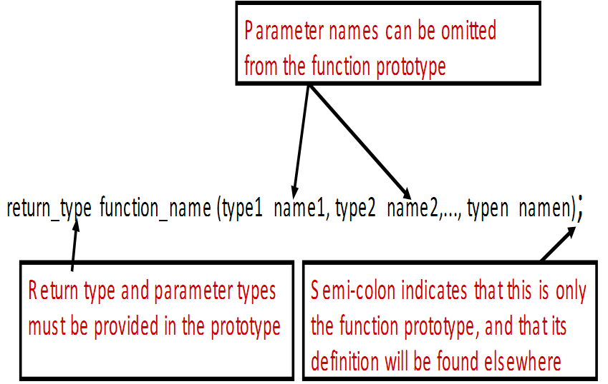
1. Function Prototype

Slide 13
1. Function Prototype
Like other identifiers in C, a function must be declared before it can be referenced
To do this, function prototype is written before main to tell the compiler what functions are to be used
A function prototype tells the C compiler
  The data type the function will return
    For example, the sqrt function returns a type of double
  The function name
  Information about the arguments that the function expects
    The sqrt function expects a double argument
So the function prototype for sqrt would be:
double sqrt(double);

Slide 14
1. Function Prototype
Examples
  int factorial (int n);
  int factorial (int); // mentioning the argument name is optional
  factorial (int); // default return type is int
  void print(void); // 1st void means no value returned, 2nd void
  means no input arguments
  void print( );
  int sum(int a, int b, int c);
  int fn(float, float);
  void draw_circle(void);
  double find_area(double r);

Slide 15
2. Function Definition
The prototype tells the compiler what arguments the function takes and what it returns, but not what it does
We define our own functions just like we do the main function
  Function Header – The same as the prototype, except it is not ended by the symbol ;
  Function Body – A code block enclosed by { }, containing variable declarations and executable statements
    In the function body, we define what actually the function does, ie., collection of program statements in C that describes the specific task done by the function
Syntax
return_type function name(type arg1, type arg2,…, typen argn)
{ // local variable declarations
/* Function Body */
return expression; }

Slide 16
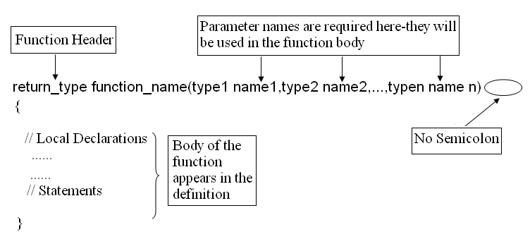
2. Function Definition

Slide 17
2. Function Definition
The function header is
return_type function name(type1 arg1, type2 arg2, …, typen argn)
Note
  The function header is similar to the function declaration but does not require the semicolon at the end
The list of variables in the function header is also referred to as the formal parameters or formal arguments
Function header consists of three parts
    the return type
    the function name
    the formal parameter list
Variables can be declared inside function body – Local Variables
Note : Function can not be defined inside another function

Slide 18
2. Function Definition
The return statement: It is the mechanism for returning a value from the called function to its caller
The general form of the return statement is as follows:
return expression;
(or)
return (expression);
(or)
return;
Return statement is used to return the result of the expression
expression – constant, variable, or expression
The calling function is free to ignore the returned value.
Expression after the return is not necessary

Slide 19
2. Function Definition
The return statement has two important uses:
  It causes an immediate exit of the control from the function. That is ,it causes program execution to return to the called function
  It returns the value present in the expression
Example:
return (x + y);
return (6 * 8);
return (3);
return;
Note: A function can return a single value using return statement

Slide 20
2. Function Definition
  int factorial (int n);
int factorial(int n)
{
int i, fact = 1;
for( i = 1 ; i <= n ; i++ )
fact = fact * i;
return (fact); // return fact;
}
n=5
i=1, fact = 1* 1 = 1
i=2, fact = 1* 2 = 2
i=3, fact = 2*3 = 6
i=4, fact = 6*4 = 24
i=5, fact = 24*5 = 120

Slide 21
3. Function call
Function will carry out its expected action whenever it is invoked (i.e. whenever the function is called) from some portion of a program
  A function call is a postfix expression
  The operand in a function is the function name
  The operator is the parameter lists (…), which contain the actual parameters.

Slide 22
3. Function call
The general form of the function call statement (or construct) is
function_name(variable1, variable2,…);
(or)
variable_name = function_name(variable1, variable2,…);
If there are no arguments to be passed in the function, i.e., the argument is void, then the calling statement would be
function_name();
(or)
variable_name = function_name();
printf(“%d”, function_name());

Slide 23
3. Function call
Parameters or arguments in function call are called as actual arguments or actual parameters
Certain rules for parameters which must be keep in mind while writing a C program which uses one or more functions
  The number of parameters in the actual and formal parameter lists must be consistent.
  Parameter association in C is positional. This means that the first actual parameter corresponds to the first formal parameter, the second matches the second and so on
  Actual parameters and formal parameters must be of compatible data types
  Actual (input) parameters may be a variable, constant, or any expression matching the type of the corresponding formal parameter

Slide 24
Note
When function prototypes are used
  The number and types of arguments must match the declared types otherwise the program causes an error message.
  The arguments are converted as if by assignment, to the declared types of the formal parameters. The argument is converted according to the following default argument promotions
    Type float is converted to double.
    Array and function names are converted to corresponding pointers
    When using traditional C, types unsigned short and unsigned char are converted to unsigned int, and types signed short and signed char are converted to signed int
    When using ANSI C, types short and char, whether signed or unsigned, are converted to int

Slide 25
Placement of Functions in a Program
In general, function prototypes are specified at the beginning (after #include or #define)
This is followed by the main function
After that, define all the user-defined functions
However, this is just a convention
As long as a function’s prototype appears before it is used, it doesn’t matter where in the file it is defined
The order we define them in does not have any impact on how they are executed

Slide 26
Anatomy of Functions
Return Type
#include <stdio.h>
#define PI 3.14159
double find_area(double r);
int main(void){
double radius, area;
printf("Enter radius : ");
scanf("%lf", &radius);
area = find_area(radius);
printf("The area is %.2f\n",area );
return(0);
}
double find_area(double r){
double a;
a = PI*r*r;
return (a);
}
Input
Enter radius : 10
Output
The area is 314.16
Formal argument
Function Declaration/Prototype
Actual argument
Function call
Caller function
Function Header
Local declarations
Function Definition
Function Body
Executable Statements
Called function

Slide 27
Functions in C
#include<stdio.h>
long factorial(int);
int main()
{
int number;
long fact = 1;
printf("Enter a number to calculate it's factorial\n");
scanf("%d",&number);
printf("%d! = %ld\n", number, factorial(number));
return 0;
}
long factorial(int n)
{
int c;
long result = 1;
for( c=1; c <= n ; c++ )
result = result*c;
return ( result );
}

Slide 28
Functions in C
#include<stdio.h>
#include<stdio.h>
int main()
{
int number;
long fact = 1;
printf("Enter a number to calculate it's factorial\n");
scanf("%d",&number);
printf("%d! = %ld\n", number, factorial(number));
return 0;
}
long factorial(int n)
{
int c;
long result = 1;
for( c=1; c <= n ; c++ )
result = result*c;
return ( result );
}

Slide 29
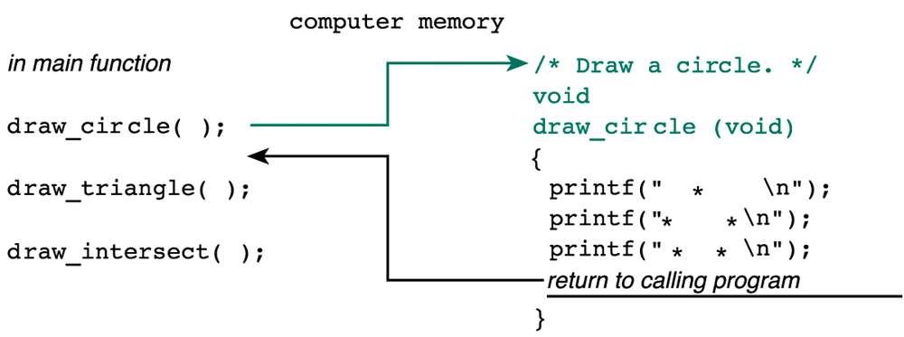
Functions in C
Flow of Control Between the main Function and a Function Subprogram

Slide 30
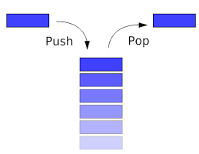
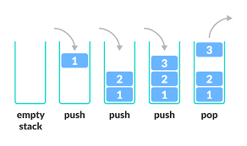
Function Call Stack and Activation Records
To understand how C performs function calls, we first need to consider a data structure known as a stack
Stacks are known as last-in, first-out (LIFO) data structures - the last item pushed (inserted) on the stack is the first item popped (removed) from the stack
Function call stack (sometimes referred to as the program execution stack) - This data structure working "behind the scenes“ supports the function call/return mechanism
LIFO behavior is exactly what a function does when returning to the function that called it

Slide 31
Function Call Stack and Activation Records
Each time a function calls another function, an entry is pushed onto the stack
This entry, called a stack frame or an activation record, contains the return address that the called function needs to return to the calling function
If the called function returns, the stack frame for the function call is popped, and control transfers to the return address in the popped stack frame
The beauty of the call stack is that each called function always finds the information it needs to return to its caller at the top of the call stack
The amount of memory in a computer is finite, so only a certain amount of memory can be used to store activation records on the function call stack. If more function calls occur than can have their activation records stored on the function call stack, an error known as stack overflow occurs

Slide 32
Function Call Stack and Activation Records
int square( int ); // prototype for function square
int main()
{
int a = 10;
printf(%d", square( a ));
return 0;
}
int square( int x )
{
return x * x;
}

Slide 33
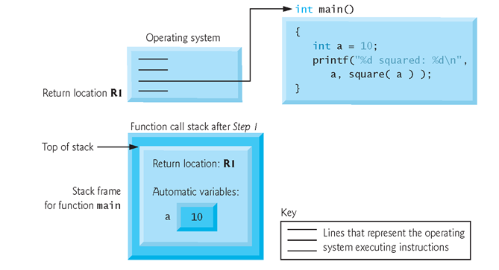
Function call stack after the operating system invokes main to execute the application

Slide 34
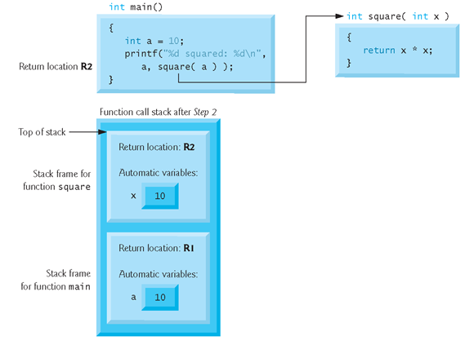
Function call stack after main invokes function square to perform the calculation

Slide 35
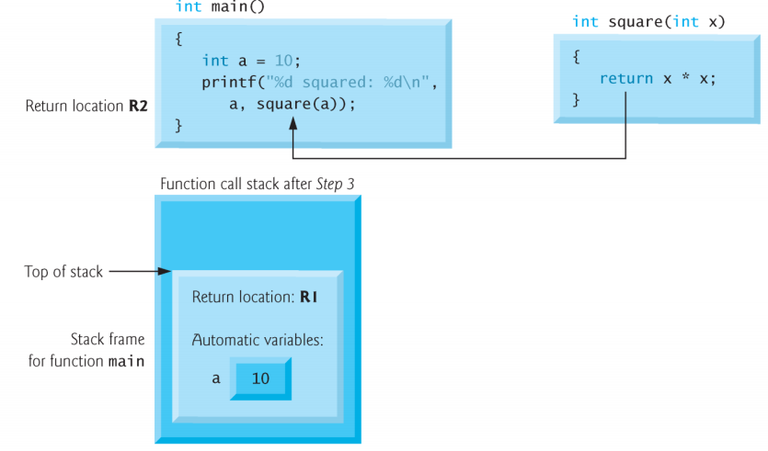
Function call stack after function square returns to main( )

Slide 36
Program Style
Each function should begin with a comment that describes its purpose
If the function subprograms were more complex, we would include comments on each major algorithm step just as we do in function main.
It is recommended that you put prototypes for all functions at the top, and then define them all after main.

Slide 37
Categories of User –Defined Functions
A function, depending on whether arguments are present or not and whether a value is returned or not, may belong to one of the following categories
Category 1: Functions with no arguments and no return values
Category 2: Functions with no arguments and return values
Category 3: Functions with arguments and no return values
Category 4: Functions with arguments and return values

Slide 38
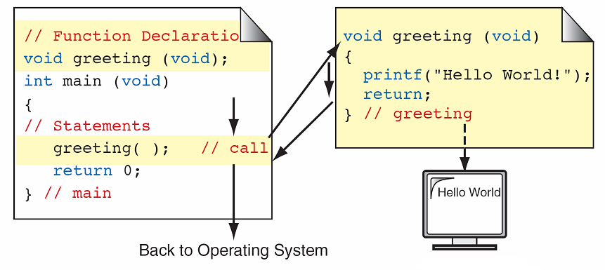
1. Functions with no arguments and no return values
This type of function has no arguments, meaning that it does not receive any data from the calling function.
Similarly function does not return any value

Slide 39
1. Functions with no arguments and no return values
#include<stdio.h>
void sum(); /* function prototype */
int main()
{
sum (); /* function calling*/
}
void sum () /* Function Definition */
{
int x, y, z;
printf (“\n Enter the values of x and y: “);
scanf (“%d%d”, &x, &y);
z=x+y;
printf (“\n The sum = %d”,z);
}

Slide 40
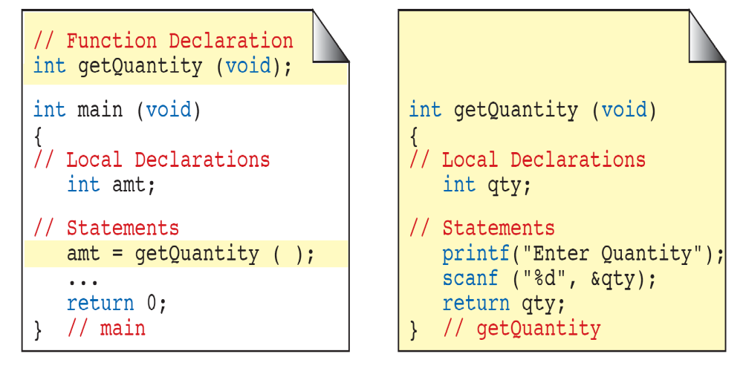
2. Functions with no arguments and return values
In this category, there is no data transfer from the calling function to the called function. But, there is data transfer from called function to the calling function
observe that the function getQuantity () do not receive any value from the function main (). But, it accepts data from the keyboard, and returns the value to the calling function

Slide 41
2. Functions with no arguments and return values
#include<stdio.h>
int sum(); /* function prototype */
int main()
{
int c;
c = sum(); /*function calling */
printf (“\n The sum = %d”, c);
}
int sum () /* Function Definition */
{
int x, y;
printf (“\n Enter the values of x and y: “);
scanf (“%d%d”, &x, &y);
/* return value to the calling function */
return x+y;
}

Slide 42
3. Functions with arguments and no return values
In this category there is data transfer from the calling function to the called function using parameters
But, there is no data transfer from called function to the calling function
Local Variables
Variables that are defined within a function are called local variables
A local variable comes into existence when the function is entered and is destroyed upon exit.
Function Arguments: The arguments that are supplied to function are in two categories
1. Actual Arguments/Parameters
2. Formal Arguments/Parameters

Slide 43
3. Functions with arguments and no return values
Actual Arguments/Parameters:
  Actual parameters are the expressions in the calling functions
  These are the parameters present in the calling statement (function call)
Formal Arguments/Parameters:
  Formal parameters are the variables that are declared in the header of the function definition
Note: Actual and Formal parameters must match exactly in type, order, and number. Their names however, do not need to match

Slide 44
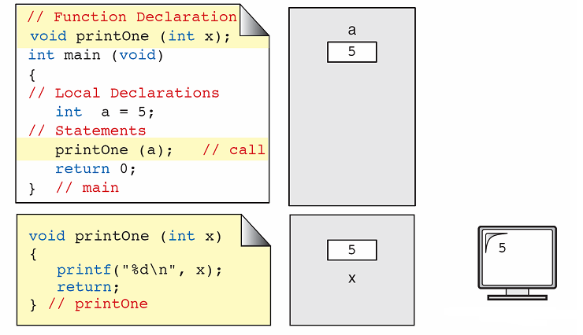
3. Functions with arguments and no return values
the function printOne () receives one value from the function main (), display the value copy of a

Slide 45
3. Functions with arguments and no return values
#include<stdio.h>
void sum(int,int); /* function prototype */
int main ()
{
int a, b;
printf (“\n Enter the values of a and b: “);
scanf (“%d%d”, &a, &b);
sum (a, b); /*calling function */
}
void sum (int x, int y) /* function definition */
{
int z;
z=x+y;
printf (“\n The Sum =%d”, z);
}

Slide 46
4. Functions with arguments and return values
In this category there is data transfer between the calling function and called function
The function sqrt() receive one value from the function main (), finds the square of the number and sends the result back to the calling function

Slide 47
4. Functions with arguments and return values
#include<stdio.h>
int sum (int , int ); /*function prototype*/
int main()
{
int a,b;
printf (“\n Enter the values of a and b: “);
scanf (“%d%d”, &a, &b);
c = sum (a, b); /*calling function */
printf (“\n The Sum =%d”, c);
}
int sum (int x, int y) /* Function definition */
{
return x+y;
}

Slide 49
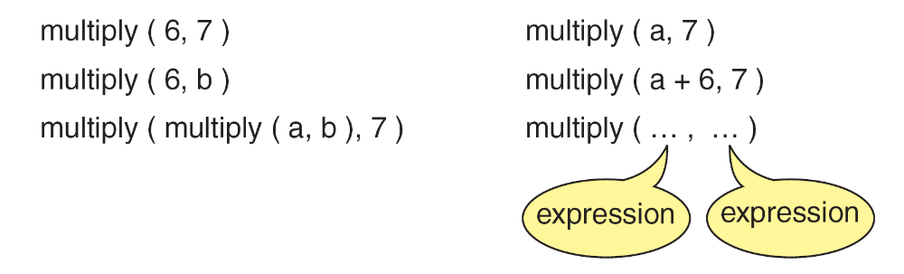
Examples of function calls

Slide 50
Nested Function calls
C permits nesting of functions, main function can call function1, function1 can call function2, which in turn calls function3 ..,
There is no limit as how deeply functions can be nested
Consider the following example:
In the below example ,when the main() function finds the function call sum(), then the control is transferred from main() to the function sum(), there sum() is calling the function read(), then the control is transferred to read() function, then the body of the function read() executes, then the control is transferred back to sum(). Again read() function is invoked.
Observe the chain of control transfers between the nested functions

Slide 51
#include<stdio.h> //Example program for nested-function calls
int read ();
int sum (int, in t);
void main ()
{ int a=0, b=0;
printf (“%d”, sum (a, b));
}
int sum (int x, int y)
{
x=read ();
y=read ();
return x + y;
}
int read ()
{ int p;
printf (“\n Enter any value: “);
scanf (“%d”, &p);
return p;
}

Slide 52
Nested Function calls
Function calls can also be nested
int max(int x,int y){return x>y?x:y;}
int main(){
int m;
m=max(max(4,max(11,6)),max(10,5));
printf("%d",m);
}
Output
11
#include<stdio.h>
increment(int m)
{
m++ ;
return(m) ;
}
int main()
{
int m=1;
m=increment(m=increment(m=increment(m)));
printf("%d",m);
}
Output
4

Slide 53
Library Functions and the Linker

Slide 54
Parameter Passing Mechanisms
Parameter passing - Data are passed to a function using one of the two techniques
  pass by value or call by value
  pass by address or call by address

Slide 55
1. Call by value
When a function is called with actual parameters, the values of actual parameters are copied into the formal parameters
If the values of the formal parameters change in the function, the values of the actual parameters are not changed
This way of passing parameters is called call by value (pass by value)
Note: In call by value any changes done on the formal parameters will not affect the actual parameters
Note:
  Actual parameter – This is the argument which is used in function call
  Formal parameter – This is the argument which is used in function definition

Slide 56
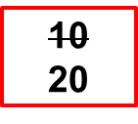
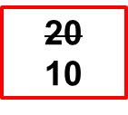
1. Call by value
#include<stdio.h>
void swap (int , int ); /*function prototype */
void main ()
{
int a, b;
printf (“\n Enter the values of a and b: “);
scanf (“%d%d”, &a, &b);
swap (a, b); /*function calling*/
printf (“\nFrom main The Values of a and b a=%d, b=%d “, a, b);
}
void swap (int x, int y) /* function definition */
{
int temp;
temp=x;
x=y;
y=temp;
printf (“\n The Values of a and b after swapping a=%d, b =%d”, x, y);
}
a b
10
20
11223 22446
x y
temp
10
77854 67531
88553

Slide 57
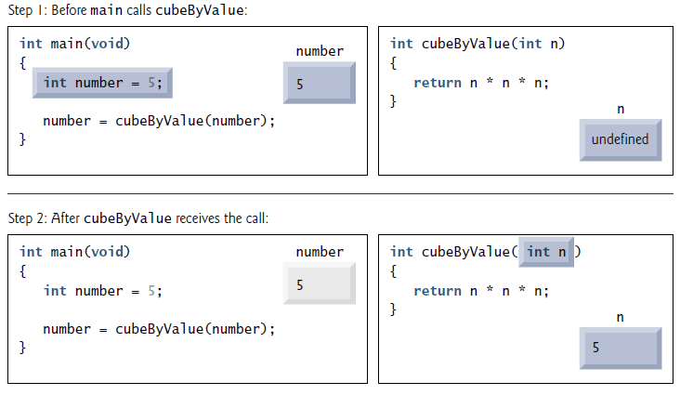
1. Call by value

Slide 58
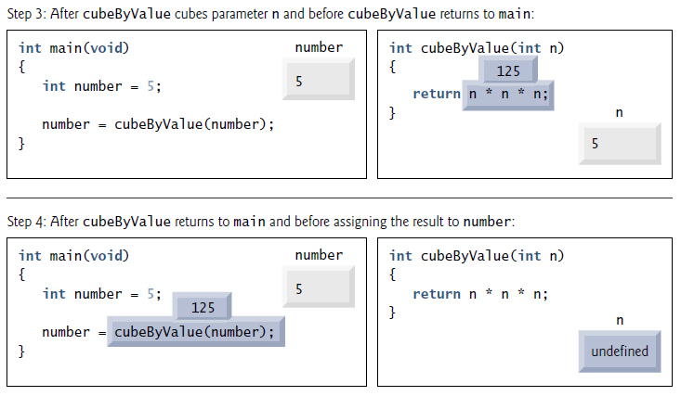
1. Call by value

Slide 59
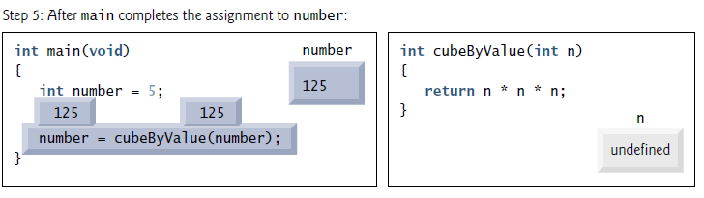
1. Call by value

Slide 60
2. Call by Address
Introduction to Pointers
  A pointer is a C variable whose value is the address of another variable of same type
  Syntax : datatype *varaiblename ;
  dataType is the pointer's base type; it must be a valid C data type(i.e., int, float, char etc).
  variablename is the name of the pointer variable.
  The asterisk * is used to declare a pointer
  Example
    int *ptr; /*Pointer to an integer*/
    float *p, *z; /*Pointer to float*/
    double *q; /*Pointer to double*/
    char *c; /*Pointer to char*/
  Note: The type of a pointer depends on the type of the variable it points to. Every pointer points to some data type

Slide 61
2. Call by Address
Output
Size of short pointer 4 bytes
Size of float pointer 4 bytes
Size of double pointer 4 bytes
#include <stdio.h>
int main()
{
short *p;
float *q;
double *r;
printf("Size of short pointer %d bytes",sizeof(p));
printf("\nSize of float pointer %d bytes",sizeof(q));
printf("\nSize of double pointer %d bytes",sizeof(r));
return 0;
}
Note : size of the pointer is the size of the memory address

Slide 62
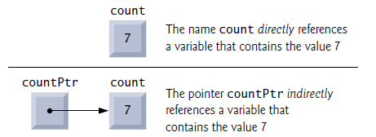
2. Call by Address
Pointers are variables whose values are memory addresses Normally, a variable directly contains a specific value
A pointer, however, contains an address of a variable that contains a specific value
In this sense, a variable name directly references a value, and a pointer indirectly references a value

Slide 63


2. Call by Address
Initializing and Assigning Values to Pointers
Pointer Representation in Memory
Initialization
int y = 5;
int *yPtr = &y;
Assignment
int y = 5, *yptr;
yPtr = &y;
To initialize a pointer variable when that pointer variable isn’t assigned any valid memory address yet, assign NULL value
int *P = NULL;

Slide 64
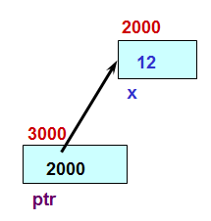
2. Call by Address
Pointer Operators
  The Address (&) Operator - is a unary operator that returns the address of its operand
  The Indirection (*) Operator – unary * operator, commonly referred to as the indirection operator or dereferencing operator, returns the value of the object to which its operand (i.e., a pointer) points
int x =12;
int* ptr;
ptr = &x;
printf(“%d”, *ptr); //12
The value pointed to by ptr is denoted by *ptr

Slide 65
2. Call by Address
int b = 20;
int *p = &b;
p b
22446
20
printf (“%d”, b); // 20
printf (“%d”, *p); //20
printf (“%u”, p); //22446
printf (“%u”, &b); //22446
printf (“%u”, &p); //11223
printf (“%d”, *b); //error
*p=100; // (or) b=100
printf (“%d”, b); // 100
printf (“%d”, *p); //100
11223 22446
p b
22446
100
11223 22446

Slide 66


2. Call by Address
void swap (int *px, int *py)
{
int temp;
temp = *px;
*px = *py;
*py = temp;
}
swap
px
py
temp
1024
9921
3
8894
2265
1137
int main ( )
{
int i = 3, j = 5;
swap(&i, &j) ;
printf (“%d,%d\n”,i,j);
return 0;
}
main
i
j
1024
9921
5,3

Slide 67
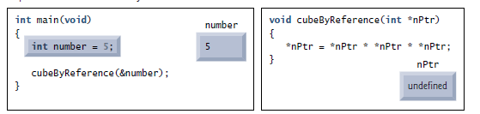
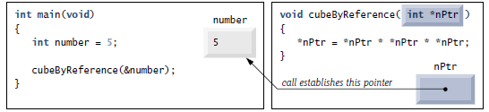
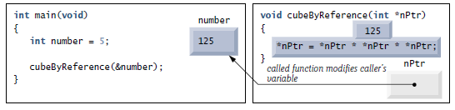
2. Call by Address

Slide 68
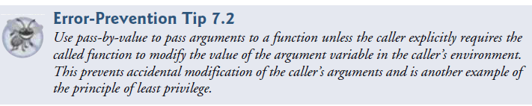
Call by Value Vs Call by Address
Call-by-Value
The value of an argument is copied into the formal parameter of the subroutine.
Changes made to the parameters of the subroutine will not affect the arguments used to call it
Call-by-Address
The address of an argument is copied into the formal parameter
Changes made to the formal parameter will affect the argument used to call the function

Slide 69
Passing arrays to Functions
When an array is an argument to a function, only the address of the first element of the array is passed (call by address), not a copy of the entire array
When a function is called with the name of the array as the argument, address to the first element in the array is handed over to the function
Therefore, array is not passed to a function by value
There are three ways to declare a parameter that is to receive an array
  as an array of the same type and size as that used to call the function
  as an unsized array
  as a pointer

Slide 70
1. Passing Arrays with Size Specification
void display(int n[10]);
int main()
{
int t[10], i;
for(i=0; i<10; ++i)
t[i] = i;
display(t); // pass array t to function
return 0;
}
void display(int n[10])
{
int i;
for(i=0; i<10; i++)
printf(“%d”, n[i] );
}

Slide 71
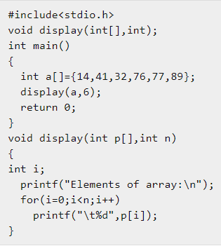
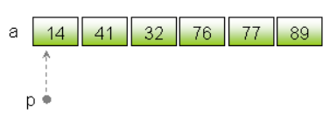
2.Passing Arrays as an unsized array
Output
14 41 32 76 77 89

Slide 72
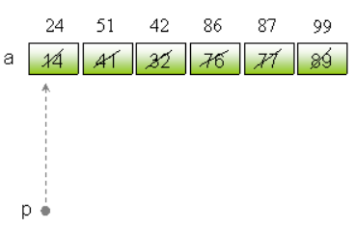
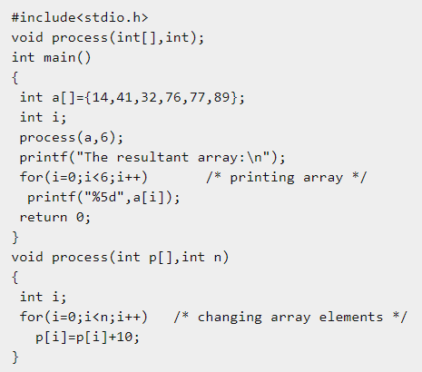
2.Passing Arrays as an unsized array
Output
24 51 42 86 87 99

Slide 73
3. Passing Arrays using a pointer
void display(int *n);
int main()
{
int t[10], i;
for(i=0; i<10; ++i)
t[i] = i;
display(t); // pass array t to function
return 0;
}
void display(int *n)
{
int i;
for(i=0; i<10; i++)
printf(“%d”, n[i] );
}

Slide 74
4. Passing Arrays using a pointer and array size information
void display(int *n);
int main()
{
int t[10], i;
for(i=0; i<10; ++i)
t[i] = i;
display(t, 10); // pass array t to function
return 0;
}
void display(int *n, int s)
{
int i;
for(i=0; i<s; i++)
printf(“%d”, n[i] );
}

Slide 75
Passing 2D arrays to Functions
To pass multidimensional arrays to a function, only the name of the array is passed to the function(similar to one-dimensional arrays)
If both dimensions are available globally (either as a macro or as a global constant)
#include <stdio.h>
const int M = 3;
const int N = 3;
void print(int arr[M][N])
{
int i, j;
for (i = 0; i < M; i++)
for (j = 0; j < N; j++)
printf("%d ", arr[i][j]);
}
int main()
{
int arr[ ][3] = {{1, 2, 3}, {4, 5, 6}, {7, 8, 9}};
print(arr);
return 0;
}
Output : 1 2 3 4 5 6 7 8 9

Slide 76
Passing 2D arrays to Functions
If only the second dimension is available globally
#include <stdio.h>
const int N = 3;
void print(int arr[ ][N], int m)
{
int i, j;
for (i = 0; i < m; i++)
for (j = 0; j < N; j++)
printf("%d ", arr[i][j]);
}
int main()
{
int arr[ ][3] = {{1, 2, 3}, {4, 5, 6}, {7, 8, 9}};
print(arr, 3);
return 0;
}
Output: 1 2 3 4 5 6 7 8 9

Slide 77
Storage Classes
Variables in C have not only a data type, they also have a storage class
Data type of a variable determines
  Range of values a variable can take
  Operations that can be applied on that specific type
A variable’s storage class describes
  Memory location (RAM or CPU registers)
  Initial value of the variable, if initial value is not specified (i.e. the default initial value)
  Scope of the variable
  Life of the variable
If we don’t specify the storage class of a variable in its declaration, the compiler will assume a storage class depending on the context in which the variable is used
  Thus, variables have certain default storage classes

Slide 78
Storage Classes
Scope of a variable
  is the portion of the program in which the variable can be referenced
  The region of the program over which the declaration of an identifier is accessible is called the scope of the identifier
Life of a variable
  is the period during which the identifier exists in memory
C Provides 4 storage class specifiers
  auto
  register
  extern
  static
A general form of variable declaration that uses a storage class is
storage_class data_type variable_name;

Slide 79
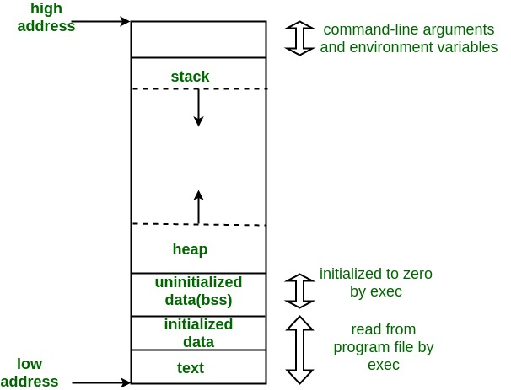
Memory Layout of C Programs
A typical memory representation of C program consists of following sections
  1. Text segment
  2. Initialized data segment
  3. Uninitialized data segment
  4. Stack
  5. Heap

Slide 80
Memory Layout of C Programs
Text Segment
  A text segment , also known as a code segment, which contains executable instructions
Initialized Data Segment
  Initialized data segment, usually called Data Segment, which contains the global variables and static variables that are initialized by the programmer
Uninitialized Data Segment
  Uninitialized data segment, often called the “bss” segment, which contains all global variables and static variables that are initialized to zero or do not have explicit initialization in source code

Slide 81
Memory Layout of C Programs
Stack
  The stack area traditionally adjoined the heap area and grew the opposite direction; when the stack pointer met the heap pointer, free memory was exhausted
  Stack, where automatic variables are stored, along with information that is saved each time a function is called
Heap
  Heap is the segment where dynamic memory allocation usually takes place
  The Heap area is managed by malloc, realloc, and free library functions

Slide 82
Storage Classes
Automatic Variable – auto
These are always declared within a function and are local to the function in which they are declared.
  Scope is confined to that function
This is the default storage class specification
  All variables are considered as auto unless explicitly specified otherwise
  The keyword auto is optional
  An automatic variable does not retain its value once control is transferred out of its defining function
Automatic variables are also be called local variables because they are local to a function in they are declared

Slide 83
Storage Classes
By default they are assigned garbage value if no initial value is provided
An automatic variable has a lifetime that begins when program execution enters the function or statement block or compound and ends when execution leaves the block.
Automatic variables are stored in a "function call stack"
Storage : Main Memory
Initial/default value: Garbage value
Scope: local to the block in which the variable is defined
Life: Life of the block

Slide 84
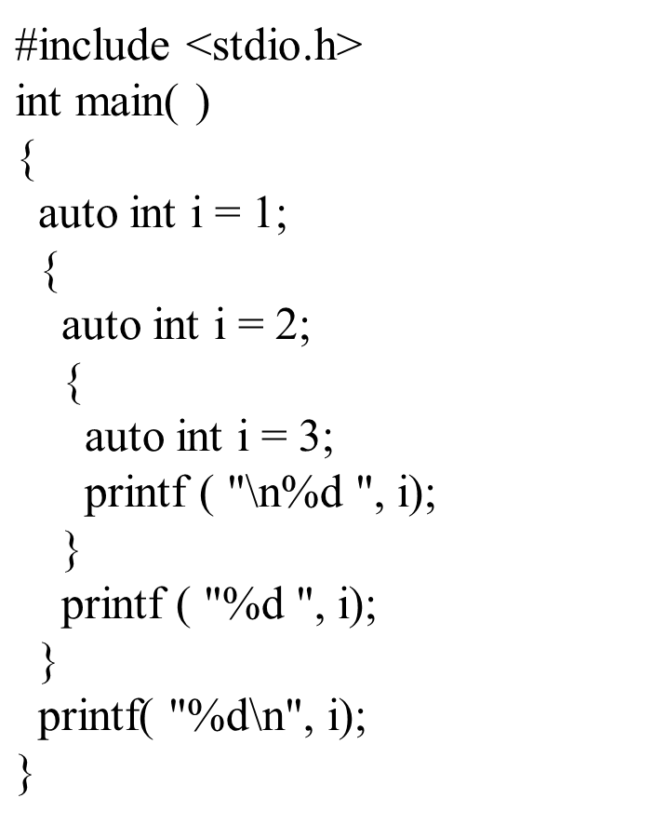
Storage Classes
#include<stdio.h>
int main( )
{
auto int i = 1 ;
{
{
{
printf ( "\n%d ", i ) ;
}
printf ( "%d ", i ) ;
}
printf ( "%d", i ) ;
}
return 0;
}
Output
3
2
1
Output : 1 1 1

Slide 85
Storage Classes
Static variables
  Static variables are defined within individual functions and have the same scope as automatic variables
  Unlike automatic variables, static variables retain their values throughout the life of the program.
    If a function is exited and re-entered at a later time, the static variables defined within that function will retain their previous values
    Initial values can be included in the static variable declaration.
    Will be initialized only once
  A static variable is stored in the data segment of the "object file" of a program
  Its lifetime is the entire duration of the program's execution
  Two kinds of variables are allowed to be specified as static variables: local variables and global variables
  Syntax : static datatype variablename;

Slide 86
Storage Classes
Static variables
  Storage place: Main Memory
  Initial/default value: Zero
  Scope: local to the block in which the variable is defined
  Life: Life of the program

Slide 87
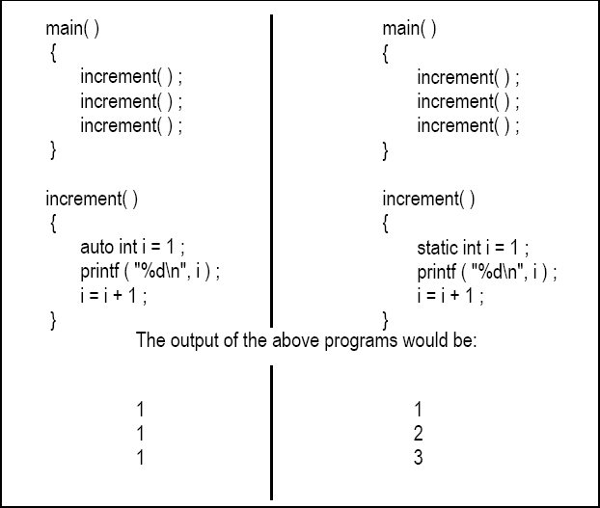
Storage Classes
auto Vs static

Slide 88
Storage Classes
Register Storage Class
A value stored in a CPU register can always be accessed faster than the one that is stored in memory. Therefore, if a variable is used at many places in a program it is better to declare its storage class as register
The keyword for this storage class is register
This storage class declares register variables which have the same functionality as that of the auto variables
This makes the use of register variables to be much faster than that of the variables stored in the memory during the runtime of the program
If a free register is not available, these are then stored in the main memory only

Slide 89
Storage Classes
Register Storage Class
Usually a few variables which are to be accessed very frequently in a program are declared with the register keyword which improves the running time of the program
The address of a register variable cannot be obtained
In most C compilers, the register specifier can only be applied to int and char type variables
Syntax : register datatype variablename;
Storage place: CPU Register
Initial/default value: Garbage value
Scope: Local to the block in which the variable is defined
Life: life of the block

Slide 90
Storage Classes
Register Storage Class
Note:
  Global variables with register storage class are not allowed
  In C, it is not possible to obtain the address of a register variable by using ‘&’ operator
  In addition, the only storage class specifier that can be used in a parameter declaration is register

Slide 91
Storage Classes
Extern Storage Class
There will be times when a variable needs to have a program-wide (global) scope and in order to allow other parts of the program to access it, it must be declared with the extern keyword.
ie., an external variable is a variable defined outside any function block
Syntax : extern datatype variablename;
Because external variables are globally accessible, they can be used instead of argument lists to communicate data between functions
They can retain their values even after the functions that set them have returned

Slide 92
Storage Classes
Extern Storage Class
An external variable may be declared inside a function. In this case the extern keyword must be used, otherwise the compiler will consider it a definition of a local variable
An external variable must be defined, exactly once, outside of any function; this sets aside storage for it
Keyword extern is used for declaring extern variables in C
It is default storage class of all global variables as well all functions
#include <stdio.h>
int i; //By default it is extern variable & this is a definition
int main()
{
printf("%d", i);
}
Output: 0
Note: If we don’t use extern keyword with global variables then compiler will automatically initialize them with default value 0

Slide 93
Storage Classes
#include <stdio.h>
extern int i; //extern variable
int main()
{
printf("%d", i);
}
Output: Compilation error,
undefined symbol i
Note : When we use extern modifier with any variables it is only declaration
i.e. memory is not allocated for these variable
To define a variable i.e. allocate the memory for extern variables it is necessary to initialize the variables.
#include <stdio.h>
extern int i=10; //extern variable definition
int main()
{
printf("%d",i);
}
Output: 10

Slide 94
Storage Classes
We cannot initialize extern variable locally
#include <stdio.h>
int main()
{ extern int i=10; //Try to initialize extern variable locally
printf("%d",i);
}
Compilation error: Cannot initialize extern variable
#include <stdio.h>
int main() {
extern int i; // It will search the initialization of variable i
printf("%d",i);
return 0;
}
int i=20; // (or) extern int i=20; Initialization of variable i.
Output: 20

Slide 95
Storage Classes
#include <stdio.h>
int main() {
extern int i; //search any initialized variable i which may be static or extern
printf("%d",i);
}
static int i=20; //Initialization of static variable i
Output: 20
#include <stdio.h>
int main() {
extern int i; //variable i is declared but not initialized
printf("%d",i);
return 0;
}
Compilation error: Unknown symbol i

Slide 96
Storage Classes
A particular extern variable can be declared many times but it can be initialized only once
extern int i; //Declaring the variable i
int i=25; //Initializing the variable i
extern int i; //Again declaring the variable i
#include <stdio.h>
int main()
{
extern int i; //Again declaring the variable i
printf("%d",i);
return 0;
}
Output: 25

Slide 97
Storage Classes
extern int i; //Declaring the variable
int i=25; //Initializing the variable
#include <stdio.h>
int main(){
printf("%d",i);
}
int i=20; //Initializing the variable
Compilation error: Multiple initialization variable i
We cannot write any assignment statement globally
#include <stdio.h>
extern int i;
int i=10; //Initialization statement
i=25; //Assignment statement
int main() {
printf("%d",i);
}
Compilation error

Slide 98
Storage Classes
#include <stdio.h>
extern int i;
int main()
{
i=25; //Assignment statement
printf("%d", i);
}
int i=10; //Initialization statement
Output: 25

Slide 99
Storage Classes
#include<stdio.h>
void d();
int main()
{
extern int i;
printf("\n%d",i);
d();
}
int i=2; //extern variable
void d()
{
printf("\n%d",i);
}
Output
2 2

Slide 100
Storage Classes
//Two.c
#include <stdio.h>
#include "c:/one.c"
extern int i;
extern int j;
int main( )
{
printf("\n%d %d",i, j);
d();
}
//One.c
int i=10; //(or) extern int i=10;
int j=20;
void d( )
{
printf("%d", i+j);
}
Output
10 20
30

Slide 101
Local variables vs Global variables
Local Variables
  Variables that are declared in a block known as local variables.
  They are known in the block where they are created and active in the block only
  They hold their values during the execution of the block
  After completing the execution of the block they are undefined
Global Variables
  Global variables are known throughout the entire program and may be used in any piece of code
  Also, they will hold their values during the entire execution of the program
  Global variables are created by declaring them outside of the function and they can be accessed by any expression
  In general, global variables are declared outside of all the functions

Slide 102
Which to use When
    Use static storage class only if you want the value of a variable to persist between different function calls
    Use register storage class for only those variables that are being used very often in a program. Reason is, there are very few CPU registers at our disposal and many of them might be busy doing something else. Make careful utilization of the scarce resources. A typical application of register storage class is loop counters, which get used a number of times in a program
    Use extern storage class for only those variables that are being used by almost all the functions in the program. This would avoid unnecessary passing of these variables as arguments when making a function call. Declaring all the variables as extern would amount to a lot of wastage of memory space because these variables would remain active throughout the life of the program
    If you don’t have any of the express needs mentioned above, then use the auto storage class. In fact most of the times we end up using the auto variables, because often it so happens that once we have used the variables in a function we don’t mind loosing them

Slide 103
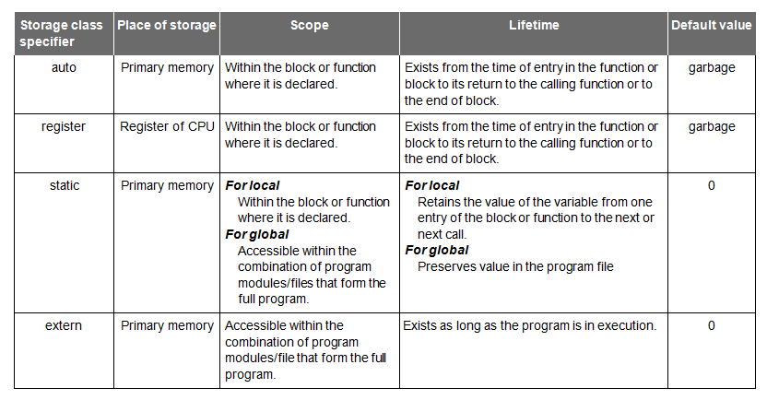
Storage Classes

Slide 104
Recursion
Recursion - The process in which a function calls itself directly or indirectly until some specified condition is satisfied
  X calls X – direct recursive call
  X calls Y, and Y calls X – indirect recursive call
Used for repetitive computations in which each action is stated in terms of a previous result
fact(n) = n * fact (n-1)
f1
f1
f2
…
fn

Slide 105
Recursive Functions : Purpose
For a problem to be written in recursive form, two conditions are to be satisfied
  It should be possible to express the problem in recursive form
  The problem statement must include a stopping condition (or base condition)
  fact(n) = 1, if n = 0
  = n * fact(n-1), if n > 0
Recursive functions are used to reduce a complex problem to a simpler-to-solve problem.
The simpler-to-solve problem is known as the base case
Recursive calls stop when the base case is reached

Slide 106
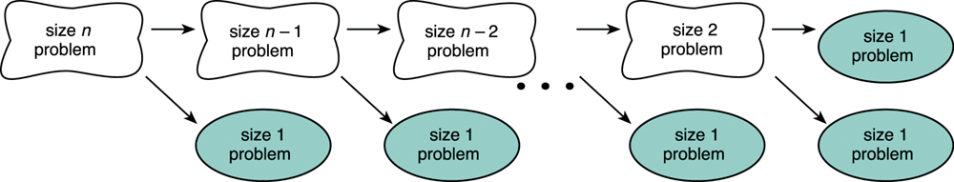
Splitting a Problem into Smaller Problems
Assume that the problem of size 1 can be solved easily (i.e., the simple case)
We can recursively split the problem into a problem of size 1 and another problem of size n-1.

Slide 107
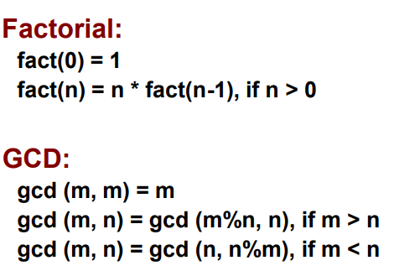
Stopping the recursion
A recursive function must always include a test to determine if another recursive call should be made, or if the recursion should stop with this call
A different value is passed to the function each time it is called
Eventually, the parameter reaches the value in the test, and the recursion stops
Examples

Slide 108
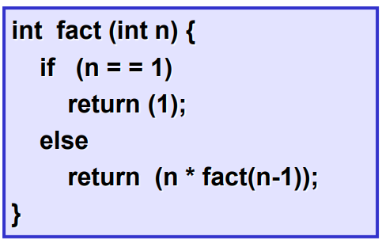
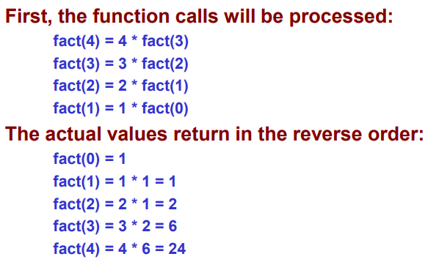
Example 1 : Factorial
Example :: Calculating fact(4)

Slide 109
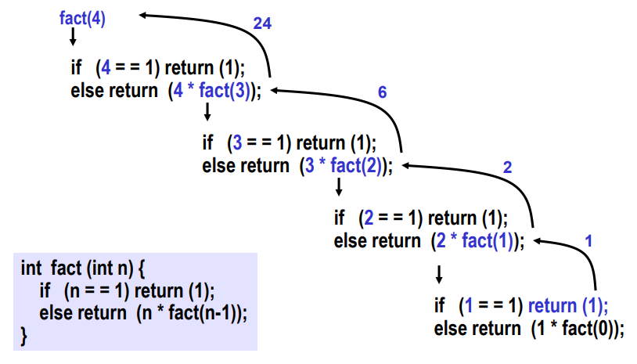
Example 1 : Factorial Execution

Slide 110
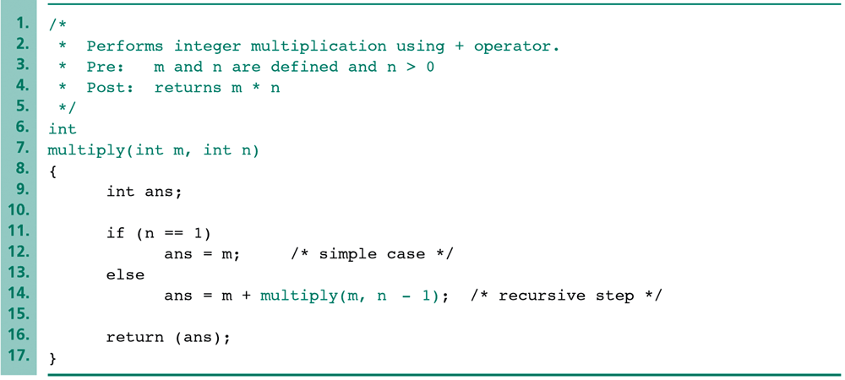
Example -2 Recursive Function
We can implement the multiplication by addition
The simple case is “m*1=m.”
The recursive step uses the following equation: “m*n = m+m*(n-1).”

Slide 111
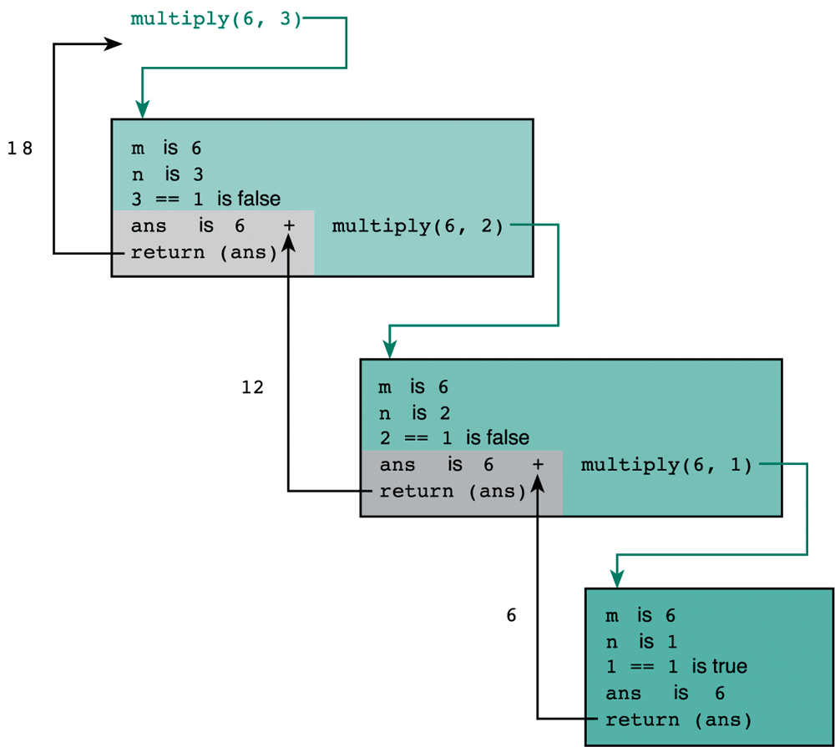
Trace of Function multiply(6,3)
The recursive step.
The recursive step.
The simple case.

Slide 113
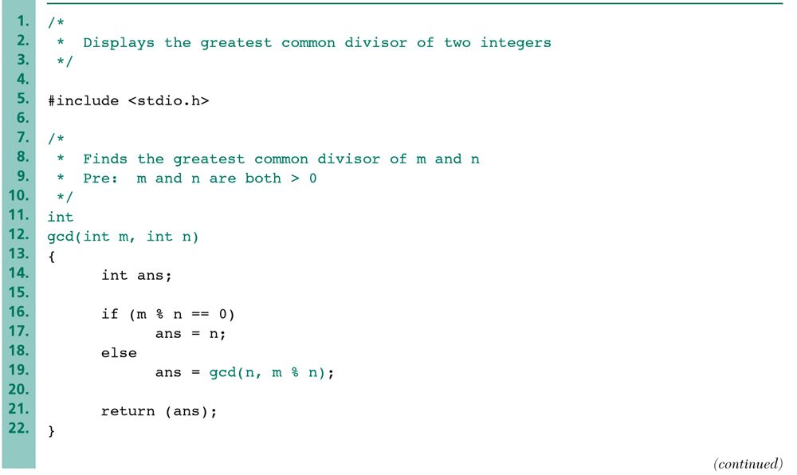
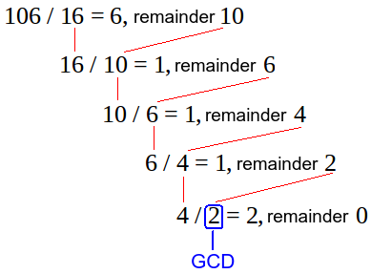
Example -3 GCD

Slide 114
How are function calls implemented?
The system maintains a stack in memory.
  Stack is a last-in first-out structure.
  Two operations on stack, push and pop
Whenever there is a function call, the activation record gets pushed into the stack
  Activation record consists of
(1) the return address in the calling program,
(2) the return value from the function, and
(3) the local variables inside the function
At the end of function call, the corresponding activation record gets popped out of the stack

Slide 115
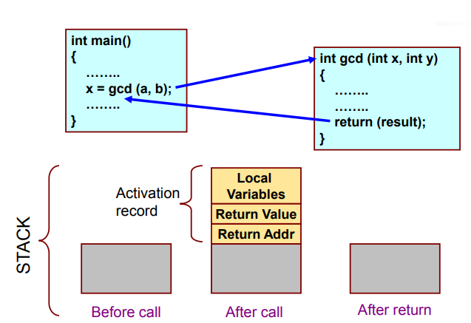
How are function calls implemented?

Slide 116
What happens for recursive calls?
What we have seen
  Activation record gets pushed into the stack when a function call is made
  Activation record is popped off the stack when the function returns
In recursion, a function calls itself
  Several function calls going on, with none of the function calls returning back.
    Activation records are pushed onto the stack continuously
    Large stack space required
    Activation records keep popping off, when the termination condition of recursion is reached

Slide 117
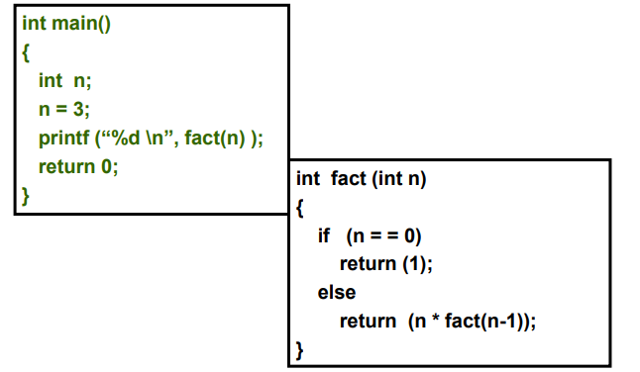
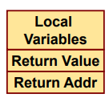
Example: main() calls fact(3)
Activation record

Slide 118
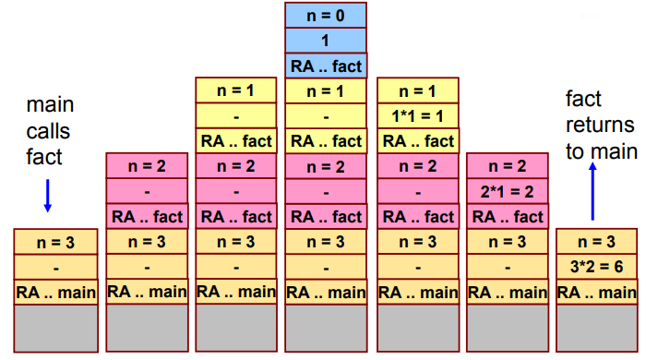
Trace of the Stack During Execution

Slide 119
Do Yourself
Trace the activation records for the following
int f(int x)
{
int y;
if(x==0)
return 1;
else {
y = 2 * f(x-1);
return y+1;
}
}

Slide 120
Note
Every recursive program can also be written without recursion
Recursion is used for programming convenience, not for performance enhancement
Sometimes, if the function being computed has a nice recurrence form, then a recursive code may be more readable

Slide 121
Recursion vs Iteration
Repetition
  Iteration: explicit loop
  Recursion: repeated function calls
Termination
  Iteration: loop condition fails
  Recursion: base case recognized
Both can have infinite loops
Balance – Choice between performance (iteration) and good software engineering (recursion).

Slide 122
Recursion vs Iteration
ITERATION | RECURSION
Iteration explicitly uses repetition structure. | Recursion achieves repetition by calling the same function repeatedly.
Iteration is terminated when the loop condition fails | Recursion is terminated when base case is satisfied.
May have infinite loop if the loop condition never fails | Recursion is infinite if there is no base case or if base case never reaches.
Iterative functions execute much faster and occupy less memory space. | Recursion is expensive in terms speed and memory

Slide 123

Recursion
int fibonacci(int i) {
if(i == 0) {
return 0;
}
if(i == 1) {
return 1;
}
return fibonacci(i-1) + fibonacci(i-2);
}
int main() {
int i;
for (i = 0; i < 10; i++) {
printf("%d\t\n", fibonacci(i));
}
}

Slide 124
End of Functions..!

